Slide 1

CYBERGUARD
Detection of inappropriate content on Social media indicating Cyberbullying
CSN 382 : Machine Learning
22114058 : Aditya Mundada
22114060 : Nayan Kakade
22114092 : Shubham Kr. Verma

Slide 2

Background
Social media fosters cyberbullying due to its open and anonymous nature.
Manual reporting not effective.
Introduce automation through Machine Learning and Deep Learning models.
PAGE 2

Slide 3
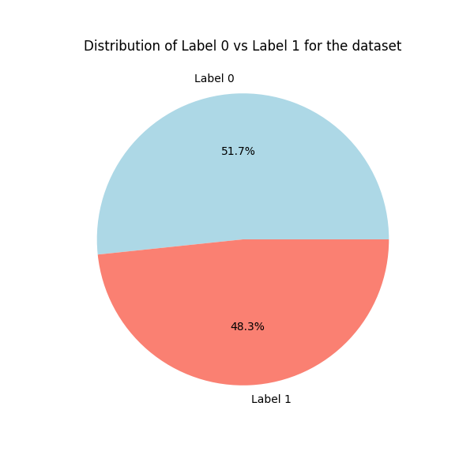
Dataset Description
Shape : (93552 , 2)
Columns : Cleaned Text | Label
Data Features : Social Media Posts
( includes posts in Hinglish)
1 = OFFENSIVE
0 = NEUTRAL
PAGE 3

Slide 4
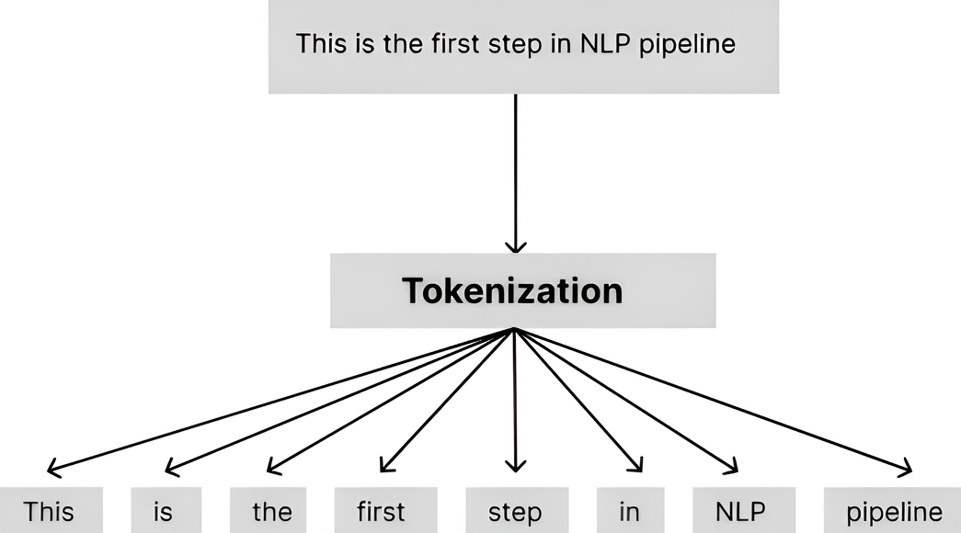
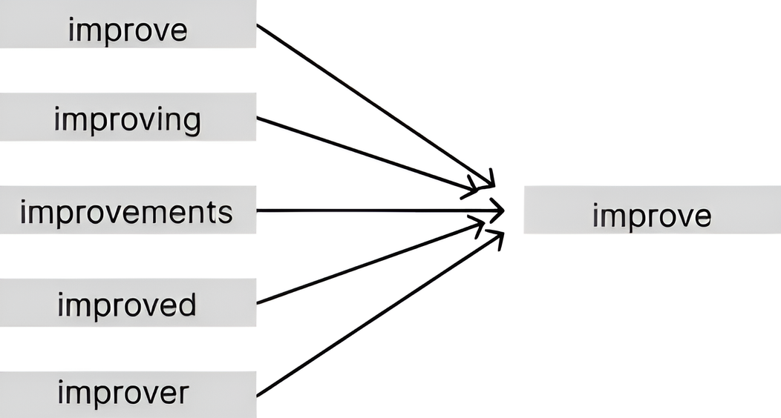
Cleaning & Preprocessing
Lowercasing
Removing special characters & punctuation
Removing stop words
Removing URLs, hashtags & mentions
Expanding Contradictions
Tokenization
Lemmatization
Vectorization
PAGE 4

Slide 5
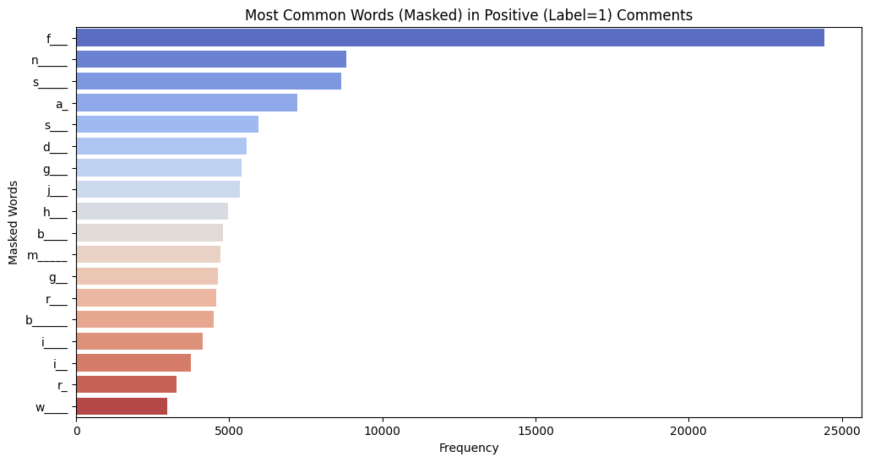
Exploratory Data Analysis
MOST COMMON WORDS
PAGE 5

Slide 6
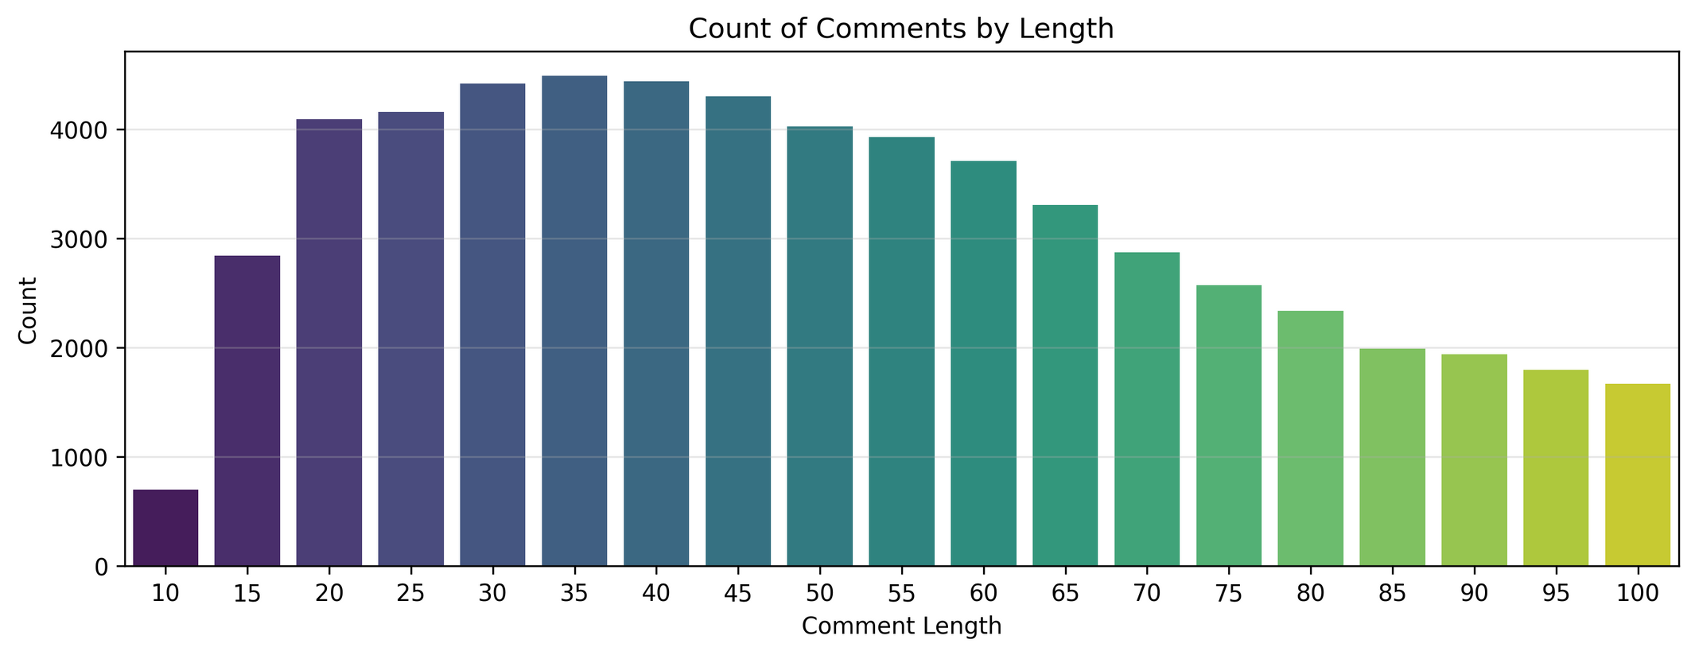
Exploratory Data Analysis
COUNT OF COMMENTS BY LENGTH
PAGE 6

Slide 7
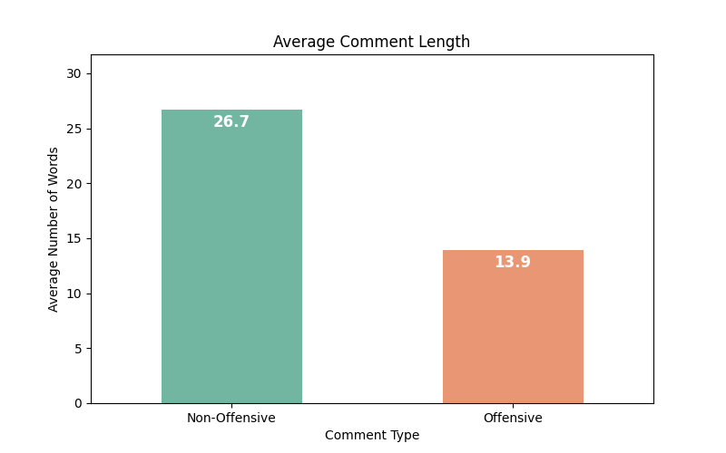
Exploratory Data Analysis
AVERAGE COMMENT LENGTH
PAGE 7

Slide 8
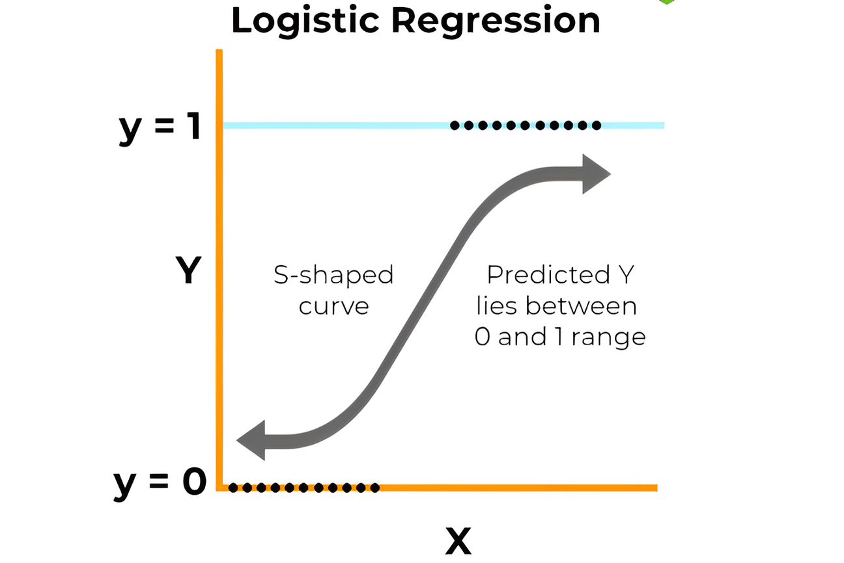
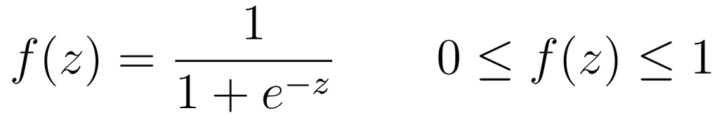
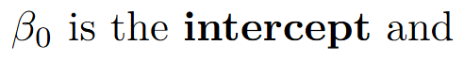
Traditional Models : Logistic Regression
Estimates the probability of an outcome, event or observation
PAGE 8

Slide 9
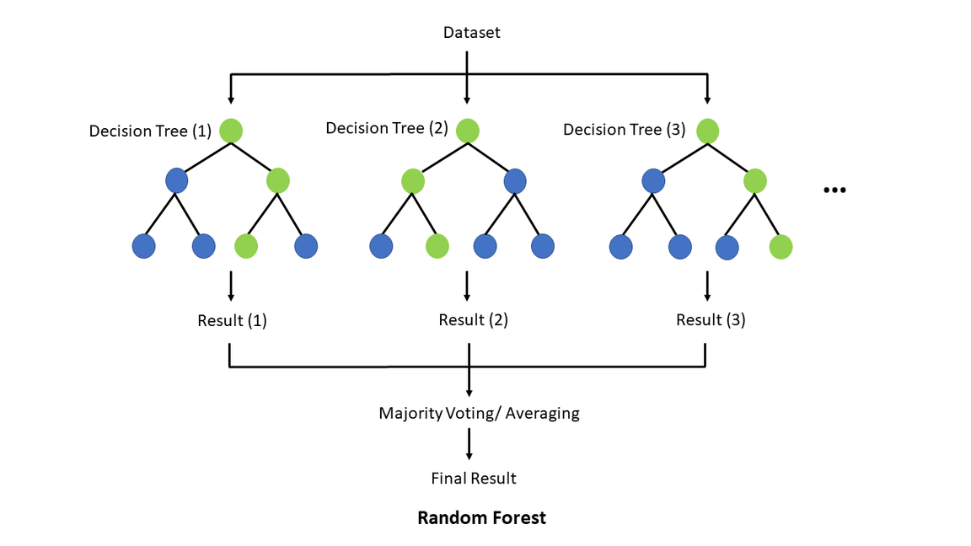
Traditional Models : Random Forests
Ensemble technique to combine multiple decision trees.
Trained on random sample & random subset of features.
Prediction by majority voting among trees for classification
PAGE 9

Slide 10
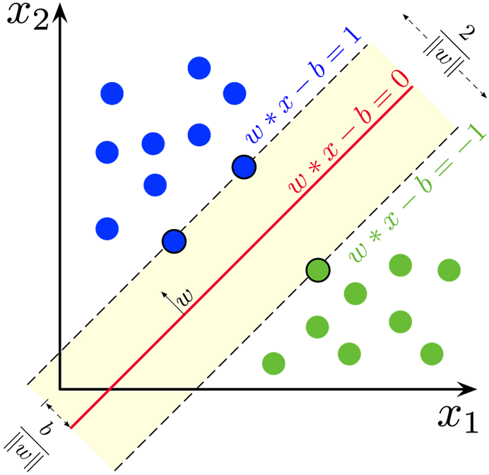
Traditional Models : Support Vector Classifier
Constructs a hyperplane or set of hyperplanes in a high-dimensional space that separates the different classes
Find best margin that separates the classes.
PAGE 10

Slide 11
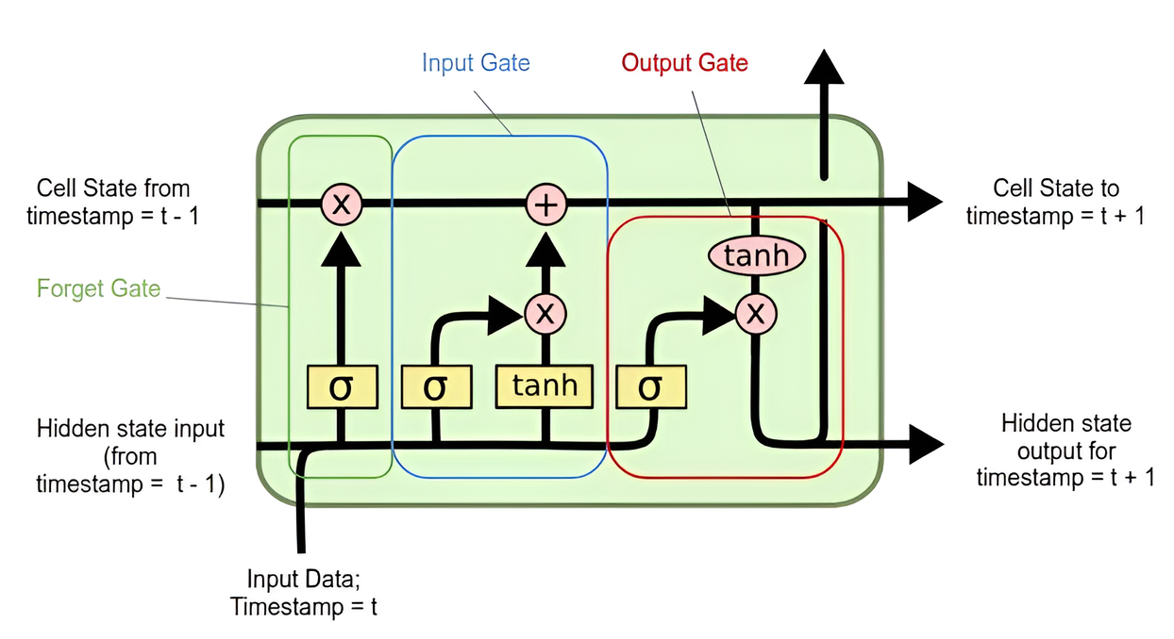
Long Short-Term Memory Network (LSTM)
An LSTM cell maintains a cell state that runs through the entire sequence chain with only minor linear interactions.
Capable of learning long-term dependencies.
PAGE 11

Slide 12
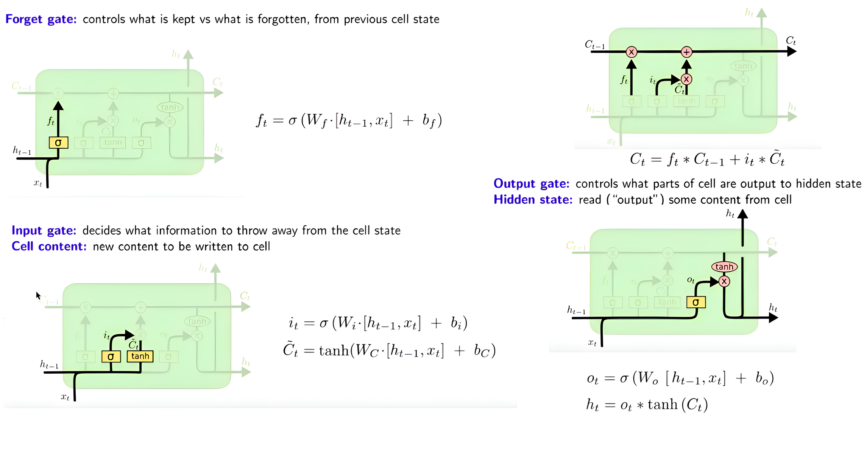
Long Short-Term Memory Network (LSTM)
PAGE 12

Slide 13
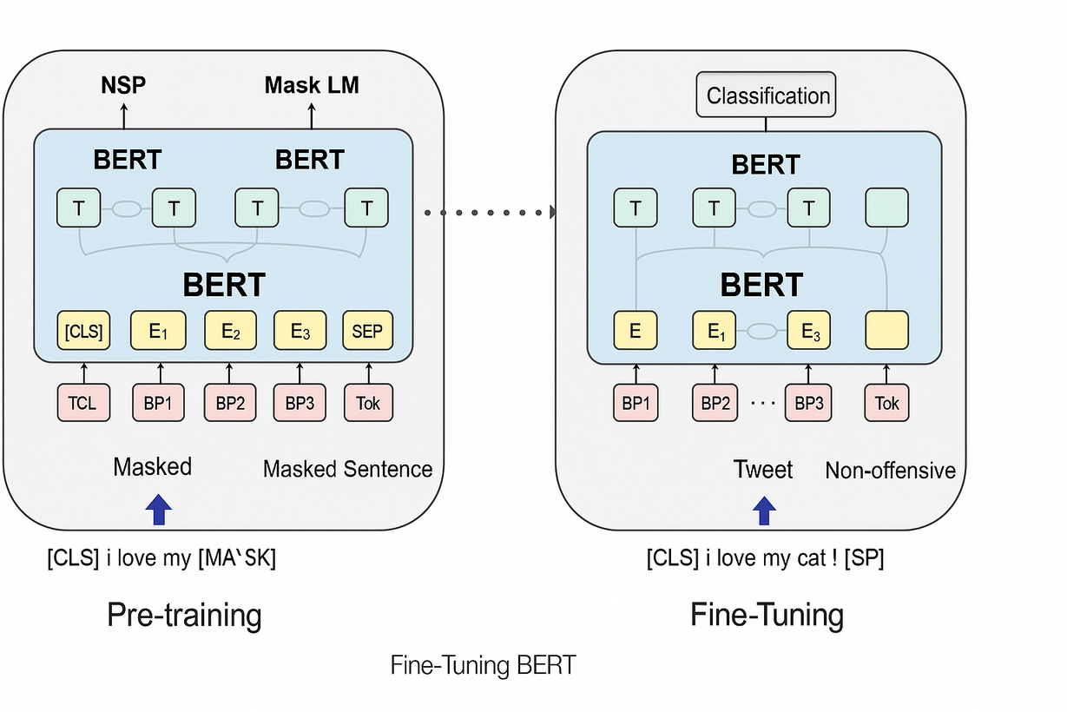
BERT
Bidirectional Encoder Representations from Transformers (BERT) is a transformer-based model introduced by Google.
It uses Attention Mechanism in order to grasp context.
It looks at context in both forward and backward directions and makes positional embeddings.
We have fine tuned BERT for our classification
task.
PAGE 13

Slide 14
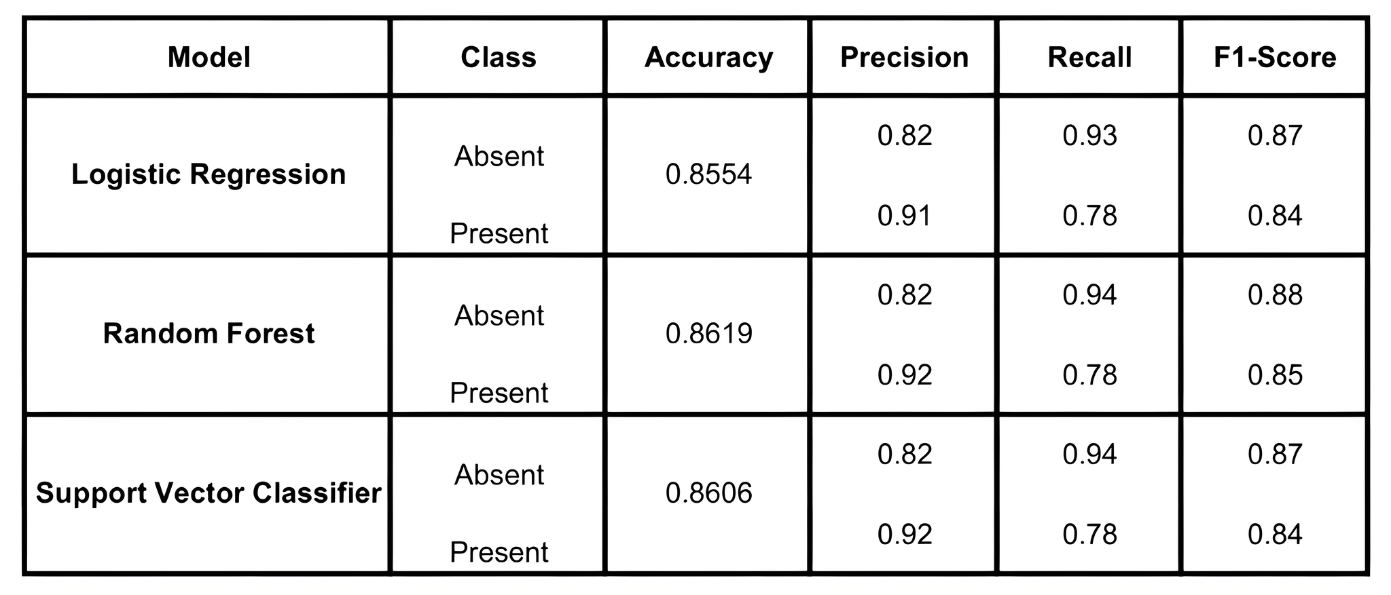
RESULTS : Traditional Models
PAGE 14

Slide 15
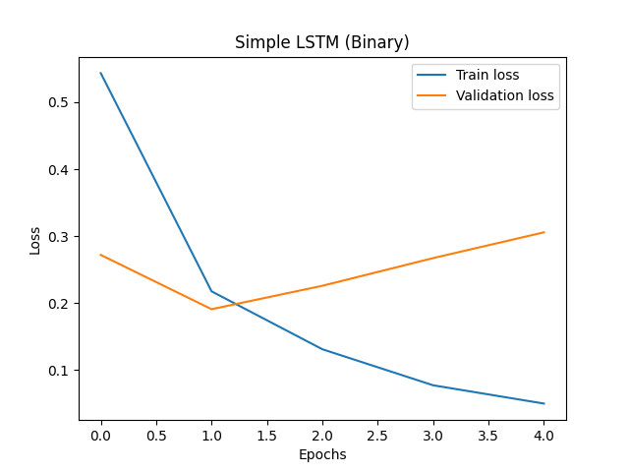
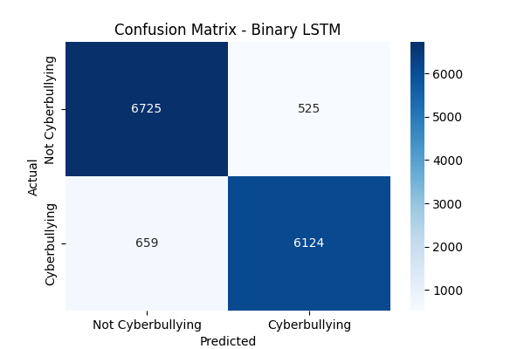
RESULTS : LSTM & BERT
PAGE 15

Slide 16
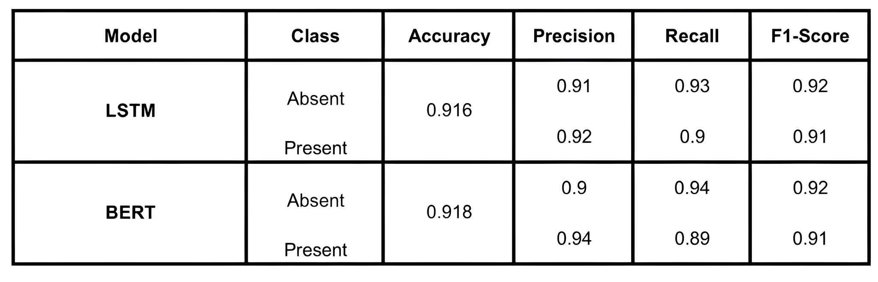
RESULTS : LSTM & BERT
PAGE 16

Slide 17
CONCLUSION
The source code of CyberGuard is available at github.
Deep learning techniques like LSTM and BERT perform better in classification of tweets based on sentiment: they can capture context efficiently while traditional models cannot.
Leveraging BERT helped us understand how pre-trained models can be used for a wide range of different tasks.
We were able to achieve good metrics on dataset that had both English and Hinglish samples, thus we solved the problem in a more Indian context.
PAGE 17

Slide 18
References
S. Shahane, Cyberbullying Dataset, Kaggle. Available at: https://www.kaggle.com/datasets/saurabhshahane/cyberbullying-dataset.
Karan Shah, Chaitaniya Phadtare, and Keval Rajpara, “Cyber-Bullying Detection in Hinglish Languages Using Machine Learning,” International Journal of Engineering Research & Technology (IJERT), vol. 11, no. 5, pp. 318–323, May 2022. Available: https://www.ijert.org/cyber-bullying-detection-in-hinglish-languages-using-machine-learning
Manish Joshi, Dhirendra Pandey, Vandana Pandey, and Mohd Waris Khan, “A fusion framework for Hinglish cyberbullying detection using mBERT and FastText,” Inter-national Journal of Engineering in Computer Science, vol. 7, no. 1, pp. 7–14, 2025. Available: https://www.computersciencejournals.com/ijecs/article/view/149/7-1-3
PAGE 18

Slide 19




THANK YOU!
PAGE 19

Slide 20
PAGE 20

